Slide 2
FEMALE REPRODUCTIVE SYSTEM
Components of the female reproductive system:
(1) a pair of ovaries
(2) a pair of oviducts
(3) a uterus
(4) a vagina
(5) the external genitalia

Slide 3
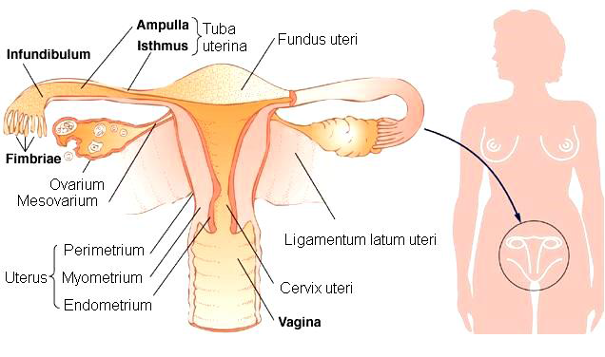

Slide 4
OVARY – lat. OVARIUM, gr. OOPHORON
Functions:
► 1. produce ova
► 2. secrete hormones – estrogens + progesterone
Histology:
● consists of a cortical and medullar regions (not sharply delineated)
● the surface of the ovary is covered by a simple cuboidal epithelium – the germinal epithelium
● under the germinal epithelium – tunica albuginea – layer of dense irregular connective tissue
A. CORTICAL REGION (CORTEX):
○ the stroma composed from connective tissue – cells respond to hormonal stimuli
○ contains numerous ovarian follicles in various stages of development
○ ovarian follicle consists of an oocyte surrounded by one or more layers of follicular cells – the granulosa cells

Slide 5
● Development of ovarian follicles:
1. Primordial follicles
2. Primary follicles
2.1. Unilaminar primary follicles
2.2. Multilaminar primary follicles
3. Secondary (antral) follicles
4. Mature (Graafian) follicles
B. MEDULLARY REGION (MEDULLA):
○ contains a rich vascular bed within a cellular loose connective tissue

Slide 6
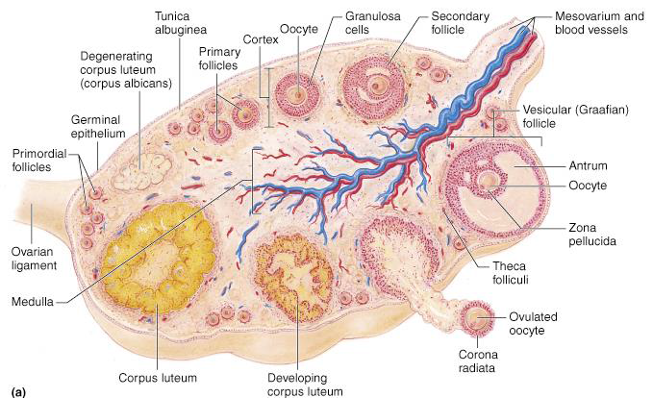

Slide 7
1.PRIMORDIAL FOLLICLES
● at the time of birth 400.000 - 1.000.000
● only few hundred maturate
● arrested in prophase of meiosis I
● Composition :
a. primary oocyte
b. single layer of flat follicular cells
● surrounded by basement membrane
GROWING FOLLICLES:
● under influence of hormones at the onset of puberty – growing and maturation of ovarian follicles
● distinct changes in morphology of oocyte, follicular cells and stroma arround growing follicle
2. PRIMARY FOLLICLES
2.1. Unilaminar primary follicle
● follicular cells form single layer of cuboidal cells
● primary oocyte

Slide 8
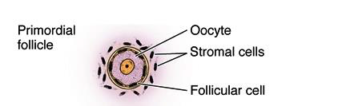
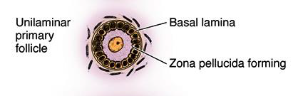

Slide 9
● follicular cells proliferate by mitosis and form a stratified follicular epithelium, or granulosa layer → multilaminar primary follicle
2.2.Primary multilaminar follicle:
Avascular part:
● primary oocyte
● granulosa layer → stratified follicular epithelium
● a thick coat – the zona pellucida composed of glycoproteins,
surround the oocyte
Vascularized part:
● stromal tissue around differentiates into two layers:
- Theca folliculi interna – cellular layer
- Theca folliculi externa- fibrous layer
● theca folliculi interna cells – production of steroid hormones

Slide 10
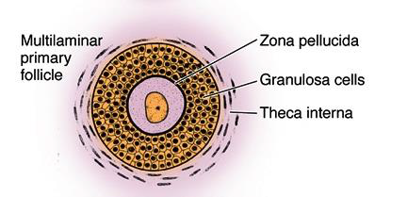

Slide 11
3.SECONDARY FOLLICLES
● liquor folliculi – fluid accumulate in the spaces between granulosa cells (plasma exudate with hormons)
4. MATURE GRAAFIAN FOLLICLE
● about 2.5 cm in diameter
● protrudes deep into cortical tissue and extends over the surface of the organ
● the granulosa cells that form the first layer around the oocyte and are in close contact with zona pellucida – become elongated and form the corona radiata
● a hillock called cumulus oophorus, carrying an oocyte – positioned off center
● antrum folliculi with follicular fluid
● oocyte prior to ovulation complete first meiotic division forming secondary oocyte
● usually only one dominant follicle undergoes ovulation

Slide 12
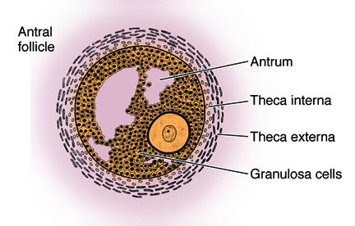

Slide 13
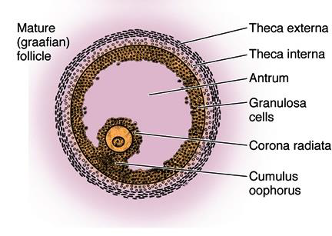

Slide 14
Ovulation
► the process of ovulation consists of rupture of the mature follicle and liberation of the ovum (into the oviduct)
► ovulation takes place approximately in the middle of the menstrual cycle – around the 14-th day of a 28-day cycle
► the stimulus is a surge of LH – Luteinizing Hormone - secreted by the anterior pituitary gland
Maturation of oocytes
►oocytes are forming during intrauterine life
►primordial follicles contain primary oocytes in on the prophase of first meiotic division
►first meiotic division is completed before ovulation (expulsion of first polar body)
►second meiotic division stops in metaphase – completed after fertilization
ATRETIC FOLLICLE
● the most ovarian follicles undergo the process – atresia → follicular cells + oocytes die and are disposed of by phagocytic cells.
● the atresia can take place during any stages in the development of a follicle
● this process is histologically characterized by:
a. stop of mitosis in the granulosa cells
b. detachment of granulosa cells from the BM
c. death of the oocyte

Slide 15
CORPUS LUTEUM (CL)
● after ovulation, the granulosa cells and those of theca interna that remain in the ovary form a temporary endocrine gland called the corpus luteum
● CL is localized in the cortical region of the ovary and persists 14 days after ovulation
● secretes hormones → progesteron + estrogens + relaxin
● the granulosa cells make up 80% of the parenchyma of the CL and are now called – granulosa lutein cells
● the cells of the theca interna form – theca lutein cells

Slide 16
OVIDUCT (FALLOPIANE TUBE) – lat. tuba uterina
Anatomy:
a. infundibulum (with fimbriae)
b. ampulla- most common for fertilisation
c. isthmus
d. intramural portion- traverses the wall of the uterus
Histology:
→ the wall is composed of 3 main layers
1) Tunica mucosa
● forms longitudinal mucosal folds (mainly in ampulla → labyrinth)
● lamina epithelialis – simple columnar epithelium
1.) CILIATED CELLS –possess many cilia- transport of the ovum and embryo
2.) SECRETORY CELLS – secrete a nutrient rich medium – nutrition of spermatozoa and preimplantation embryo
● lamina propria – loose connective tissue (is richly vascularized!)
(B) Tunica muscularis
● consists of smooth muscle cells disposed as:
1) INNER CIRCULAR (SPIRAL) LAYER
2) OUTER LONGITUDINAL LAYER
(C) Tunica serosa
● composed of visceral peritoneum (mesothelium + submesothelial layer)
Lamina

Slide 17
UTERUS
Function:
● during pregnancy – houses and support the developing embryo and fetus
Anatomy:
a. body (corpus uteri) – major part
b. cervix – narrow lower part
c. fundus – upper part (entrances of the oviducts)
* dense connective tissue of the lateral part of uterus form the broad ligament
Histology:
● the uterus is a thick-walled organ, wall consists of 3 layers:
A – tunica mucosa – ENDOMETRIUM
B – tunica muscularis – MYOMETRIUM
C – tunica serosa – PERIMETRIUM
* PARAMETRIUM – dense regular C.T. of the broad ligament

Slide 18
ENDOMETRIUM
● consists of lamina epithelialis and lamina propria
● epithelial lining – simple columnar epithelium containing secretory and ciliated cells
● lamina propria – loose connective tissue with many stellate fibroblasts, contains abundant amorphous ground substance→ uterine glands – simple tubular glands (covered by simple columnar epithelial cells)
● Layers of endometrium:
1. Zona functionalis
○ superficial layer
○ exhibit dramatic changes during menstrual cycle every month as a result of hormonal changes
○ shed during menstruation !
2. Zona basalis
○ basal layer adjacent to the myometrium
○ undergoes little changes during the menstrual cycle
○ not shed during menstruation !
○ provides a new epithelium and lamina propria for the renewal of the endometrium.

Slide 19
ENDOMETRIAL BLOOD SUPPLY
○ the endometrium has a unique dual blood supply
○ the uterine artery distributes blood to arcuate arteries in the middle layer of the myometrium
○ from these vessels, 2 sets of arteries arise to supply blood to the endometrium:
(1) STRAIGHT (BASAL) ARTERIES → which supply the zona basalis
(2) COILED (SPIRAL) ARTERIES → which bring blood to the zona functionalis and undrrgo pronounced changes during menstrual cycle
MYOMETRIUM
● thick muscular layer (4 poorly defined layers)
● composed of bundles of smooth muscle cells separated by connective tissue
● inner and outer layers are longitudinal, thick middle circular
● the middle layers contain the larger blood vessels (arcuate arteries)- stratum vasculare
● myometrium thicknes during pregnancy because of the hypertrophy and hyperplasia of individual smooth muscle cells
PERIMETRIUM
● submesothelial connective tissue and mesothelium

Slide 20
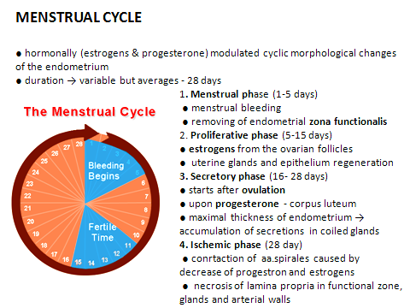

Slide 21
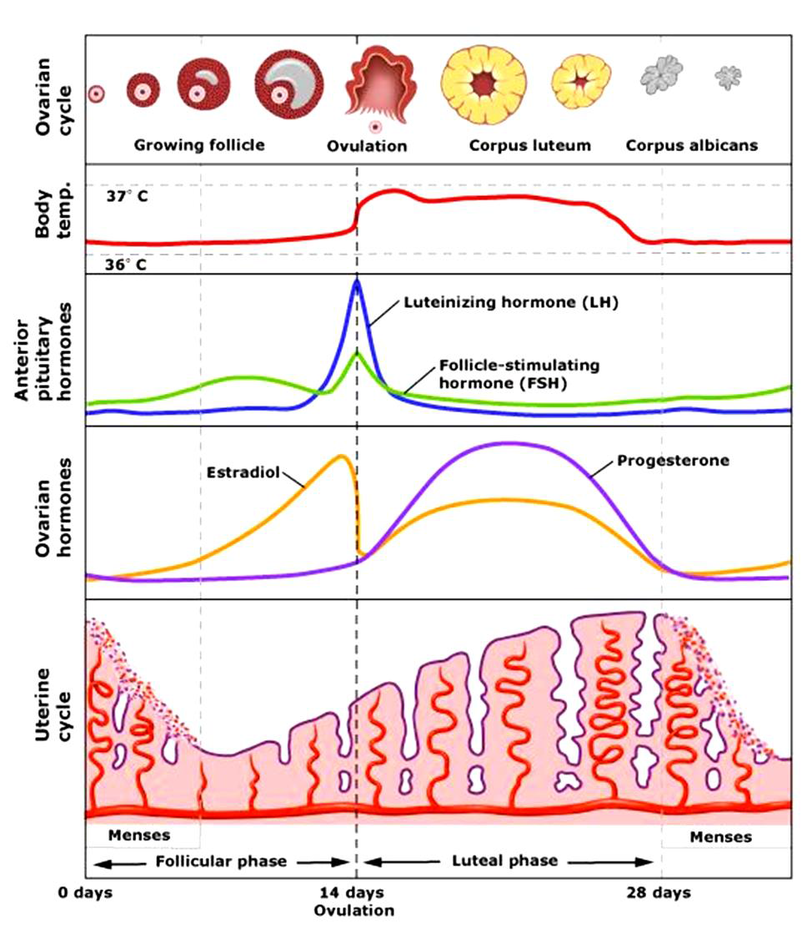

Slide 22
